Slide 1

U.S. House of Representatives 2016 Elections: a Predicting Margin of Victory
Alex Douglas

Slide 2
Overview
Goal:
Predict margin of victory for the 2016 U.S. House of Representatives elections
Variables:
Biographical information
Non-biographical information
length in office, party affiliation, previous margin

Slide 3
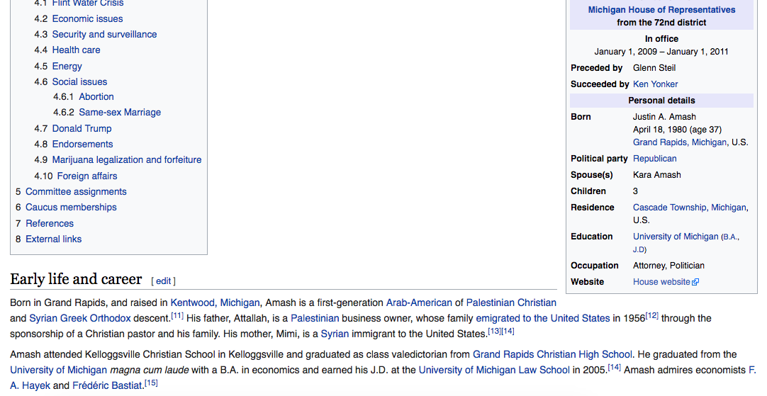
Age
Marital Status
Children
Education
Previous Occupation

Slide 4
Overview
Goal:
Predict margin of victory for the 2016 U.S. House of Representatives elections
Variables:
Biographical information
Non-biographical information
length in office, party affiliation, previous margin

Slide 5

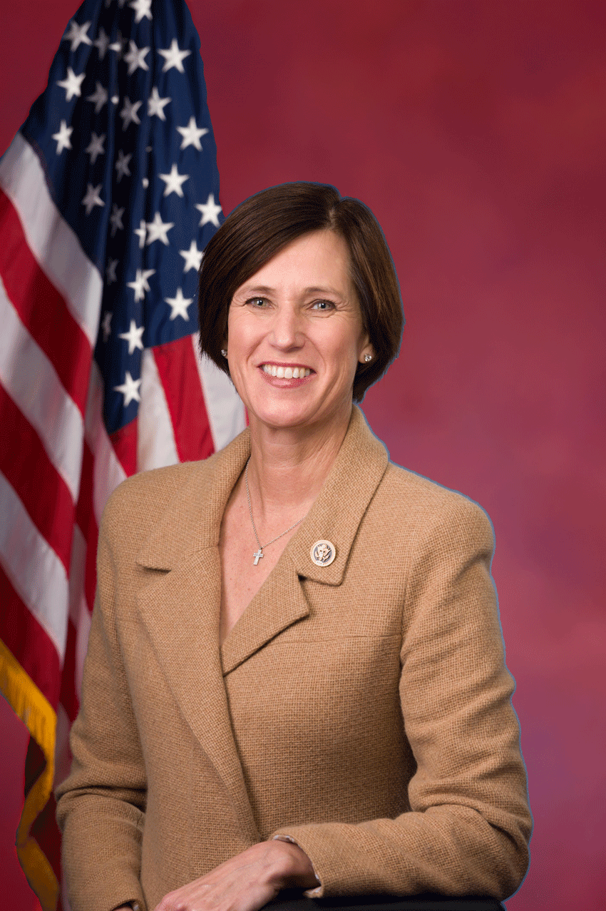



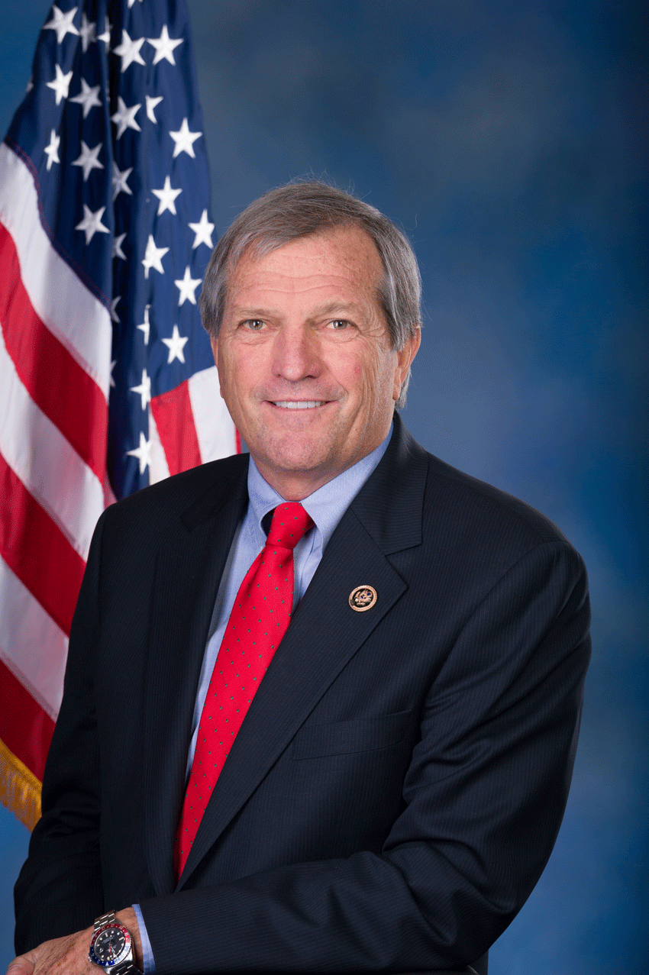
Who will win by a higher margin?
Republican
Female
Age: 55
Unmarried
Married
Children: 4
Male
Children: 1
Age: 65
Democrat
Significant
Party (p < 0.001)
Insignificant
Children (p = 0.33)
Marital Status (p = 0.13)
Age (p = 0.98)
Gender (p = 0.23)
Mimi Walters (Cal 45)
Mark DeSaulnier (Cal 11)

Slide 6
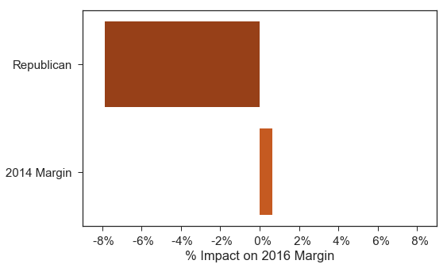
Significant Variables
-7.86%
+0.63%

Slide 7
Most Important Variable
Margin of Victory in 2014
p < 0.001
0.40 Adjusted R²
Mimi Walters
Mark DeSaulnier
2014 Margin: 30.2%
2016 Margin: 17.1%
Margin Diff: -13.1%
2014 Margin: 34.5%
2016 Margin: 44.1%
Margin Diff: 9.6%

Slide 8
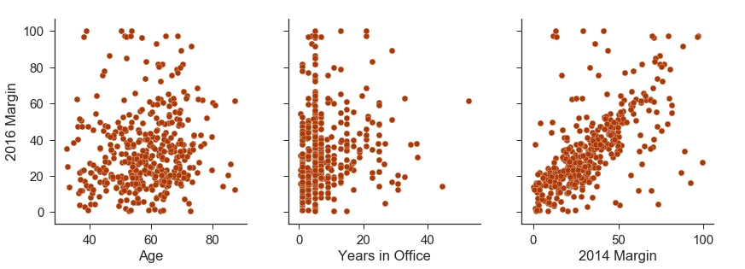
Sample Variable Values vs. 2016 Margin

Slide 9
Conclusion
Only party affiliation and previous results matter
Does not appear to be implicit bias against candidates based on basic biographical stats
Follow Up Questions
Biographical information in closely-contested elections
In-district margin changes with new candidate

